Slide 1
MetroMove Transit Solutions
Optimizing Public Transit Operations

Slide 2
Agenda
Data Cleaning
Data Explorations
Descriptive Statics
Analysis(Univariable,Bivariable,Multivariable)
Visualizations
Show of my Jupyter Notebook Sintax’s

Slide 3
Our Mission is to improve passenger experience while optimizing efficiency, affordability with a timely public transportation.

Slide 4
We Will Be Reviewing
*Understanding Passenger Usage Patterns
*Evaluating the Performance of Different Transport Modes.
*Analyzing how Trip Characteristics Impact Customer Experience.

Slide 5
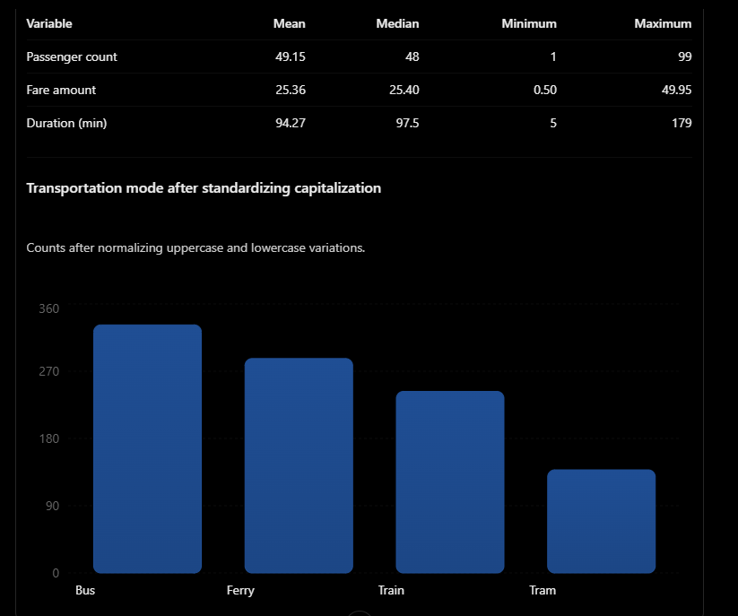
The bus is the most frequently recorded transportation method, with 332 trips and 14,936 recorded passengers. Ferry follows with 13,104 passengers.
However, tram has the highest average passenger count per trip, at approximately 51 passengers.
This suggests that buses contribute the largest overall passenger volume, while trams have a slightly higher average passenger loading per recorded trip.
Notes:
Understanding passenger usage patterns

Slide 6
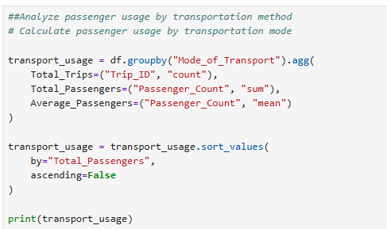
Python’s Explanation

Slide 7
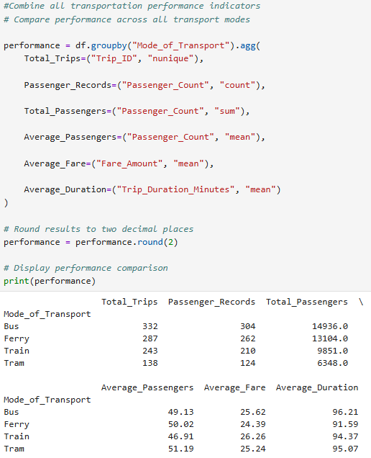
Notes:
Here We can Evaluate the different performances of transportation modes

Slide 8
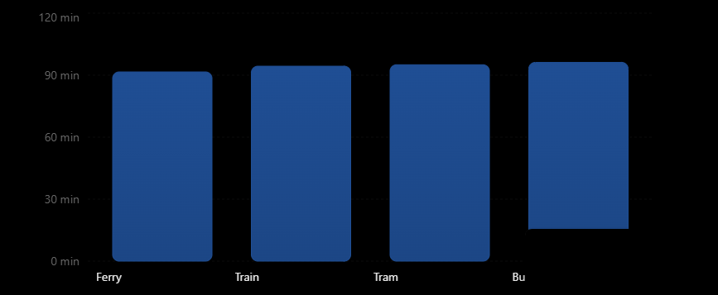
This Chart shows that ferries have the shortest average recorded trip duration, at approximately 92 minutes, whereas buses have the longest average duration, at approximately 96 minutes.
This suggests that passengers using ferries spend less time travelling on an average recorded trip. However, we would need route distances and passenger feedback to determine whether this translates into a better customer experience.
##Calculate average trip duration by transport moderation_analysis = df.groupby("Mode_of_Transport")[ "Trip_Duration_Minutes"].mean().sort_values()print(duration_analysis)
Notes:
Analyzing how trip characteristics impact customer experience- short trips

Slide 9
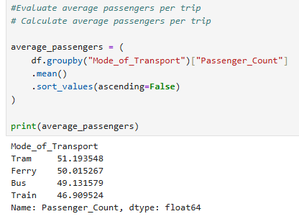
Trams have the highest average passenger count, at approximately 51 passengers per trip.
This indicates relatively higher average passenger demand per tram trip.
Notes:
Passenger count on each – Again no relevant information how this impacts customer experience

Slide 10
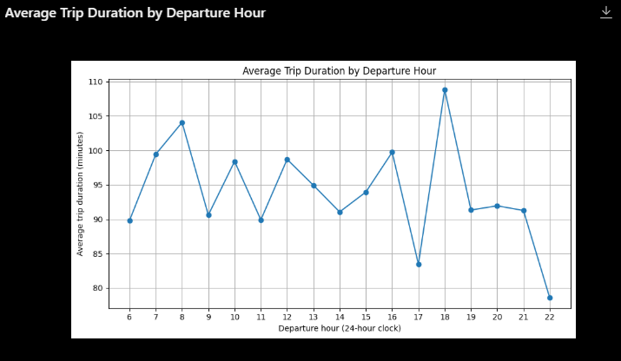

Notes:
How long each mode of transportation is depending on departing hour

Slide 11
Suggestions to improve customer experiences
The Dataset does not provide vehicle capacity, route distance, customer satisfaction scores or service reliability measurements. We don’t have enough of the right kind of Data to know where or how to improve the customer experience for MetroMove Transit Solutions.
The Dataset contains 100 missing values in each of passenger_count, fare_amount and trip_duration_minutes not providing us with full information.
Suggestions would be to survey each mode of transportation in the service of reliability with time departures and arrivals and their capacity, security the route distance and fare promo deals compared to regular fare prices. This way we can see where the customers experiences would need to improve to generate more income with their satisfactions.
Another suggestion to be considered is time of year, month and day can fluctuate the modes of transportation experiences also depending on time of day.

Slide 12
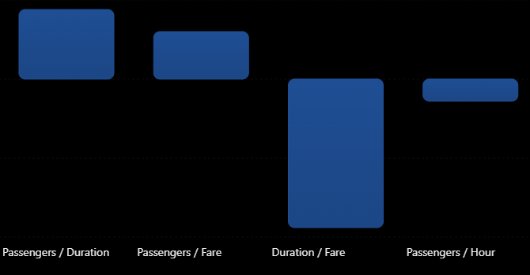
Conclusion
The correlations are all very close to zero. This indicates that the dataset does not show strong linear relationships between passenger numbers, fares, trip duration, and departure hour.
A higher passenger count does not appear to be strongly associated with a longer trip duration.
This is an important finding because it suggests that other factors not included in the dataset may be relevant to understanding passenger experiences.
Notes:
Fare seems to play the biggest factor in an increase in passenger public transportation usage.

Slide 13
Summary
First, I examined trip duration to understand how much time passengers spend travelling. The analysis showed that ferries had the shortest average recorded trip duration, at approximately 92 minutes, while buses had the longest, at approximately 96 minutes.
Second, I analyzed fare amounts to investigate affordability. Ferries had the lowest average recorded fare, approximately 24.39, while trains had the highest, approximately 26.26.
Third, I examined passenger counts to investigate passenger demand and potential crowding. Trams recorded the highest average passenger count per trip, at approximately 51 passengers.
Fourth, I analyzed departure times to identify periods of higher passenger demand. The results showed that passenger activity was relatively high around 8:00 AM and 9:00 PM.
Finally, I performed correlation analysis to understand the relationships between passenger counts, fares, and trip duration. The results showed very weak relationships between these variables.
The findings can help transportation providers identify opportunities to improve scheduling, review fare structures, manage passenger capacity, and enhance the overall quality of public transportation services.
However, because the dataset does not contain customer satisfaction ratings or passenger feedback, additional research would be required to determine how these trip characteristics directly affect customer satisfaction.
.

Slide 14
Thank-You
Presented by: Manal I.

